Slide 1
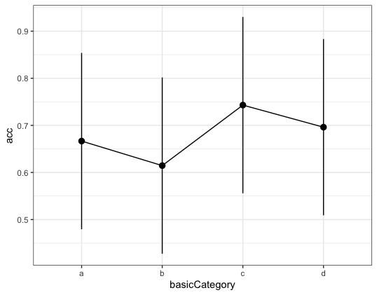
Cover Task : size judgement.
If this could be put into a 20 inch carry-on suitcase?
3-d length in cm
A 30s break in the middle
256 trials altogether

Slide 2
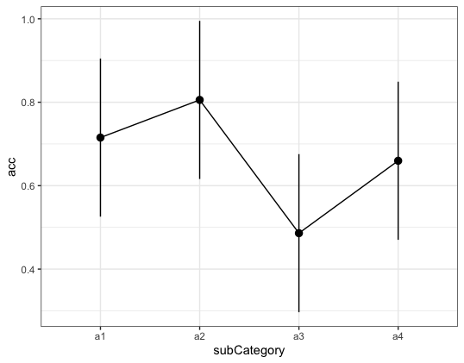
A1 – bluejay
A2 – canary
A3 – peacock
A4 - Ostrich
Uncommon large bird?

Slide 3
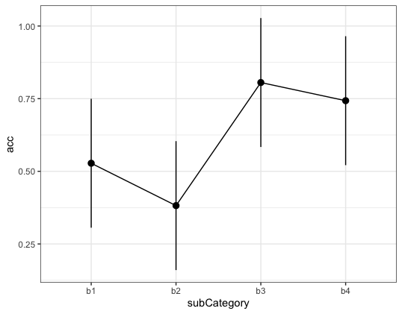
B1 – hare
B2 – fox
B3 – lion
B4 - deer
Why hare could not be put the suitcase? Fox is not too much larger than domestics cat

Slide 4
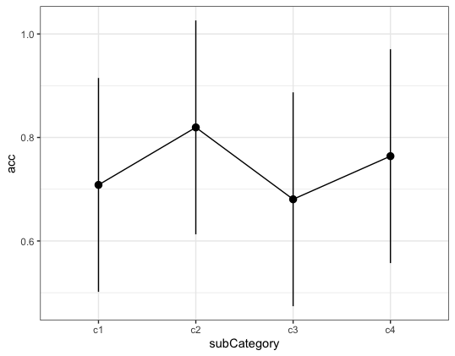
C1 – hammer
C2 – screwdriver
C3 – hoe
C4 - rake

Slide 5
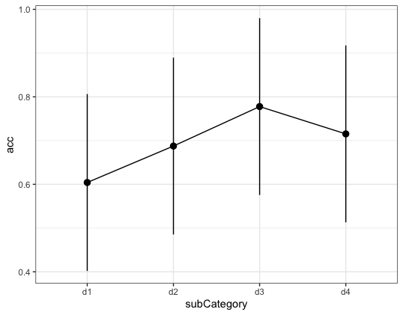
D1 – mixer
D2 – kettle
D3 – oven
D4 - dishwasher

Slide 6
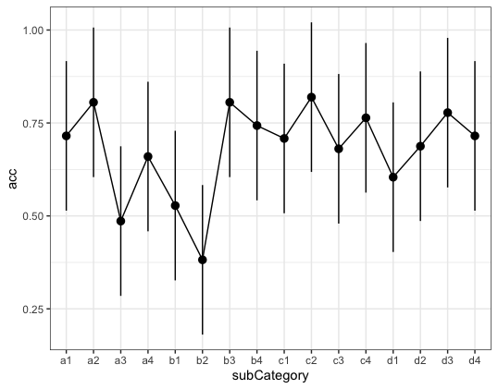
Instructions give 3-d data with inches
Add reference photo at the beginning and middle break
New concept selection: 1. hammer screwdriver hoe rake
2. toaster kettle oven dishwasher
3. bear deer squirrel hamster
4. guitar, harp, flute, harmonica
Category vs shared features?
Longer exposure time?
Practice materials

Slide 7
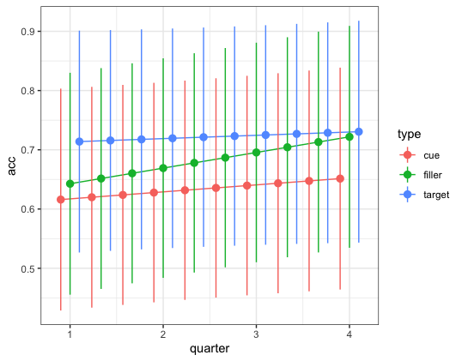
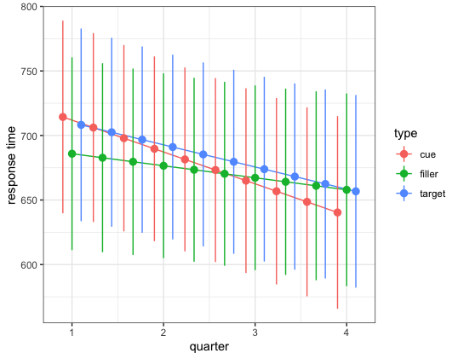
Predicting or practice effect?

Slide 11
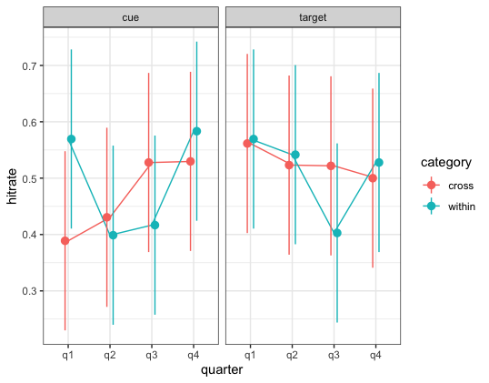

Slide 12
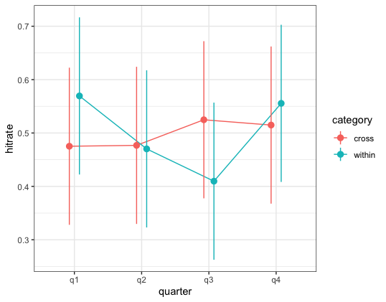

Slide 13
